Slide 1
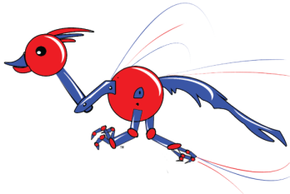
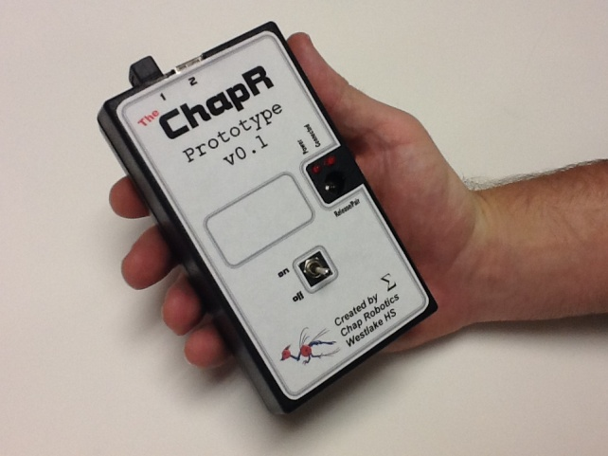
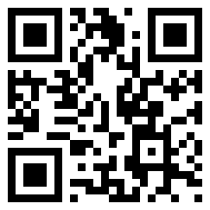
Outreach
ChapR
Fundraising/Donations
We make a 25% profit on each ChapR, and we use those profits to fund ChapRs for less fortunate teams. Donations are encouraged; we love helping out teams in need. If you’re a team who doesn’t think a ChapR is the best decision for their budget, let us know and we can try to get you one for free.
General Info
The ChapR allows for drive practice without a PC, allowing for increased convenience.
About Chap Robotics
Chap Robotics now has 4 FTC teams (one of which, the Pi-Rho Maniacs, is here in St. Louis) and 1 FRC team (Team Appreciate, also here for the competition).
Features include:
Bluetooth connection to NXT brick (no computer needed!)
2 joysticks can be plugged in for driving
Button release of waitForStart() in selected program
Minimal lag
Come check us out at:
http://chapr.weebly.com/

Slide 2
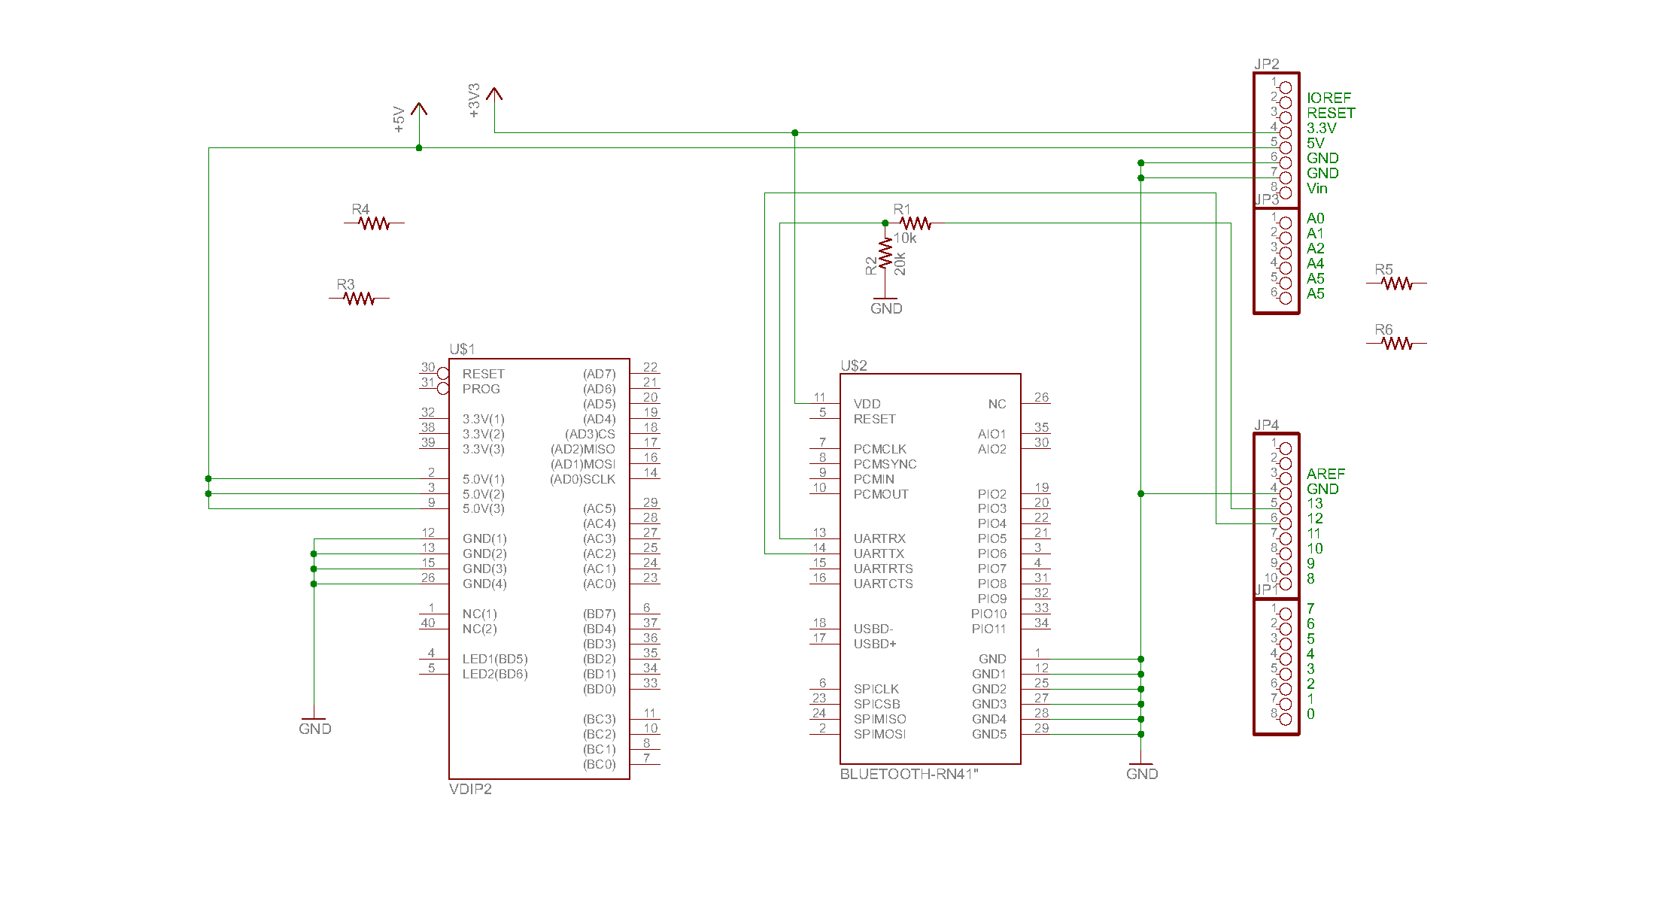
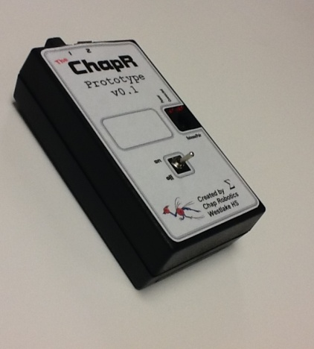
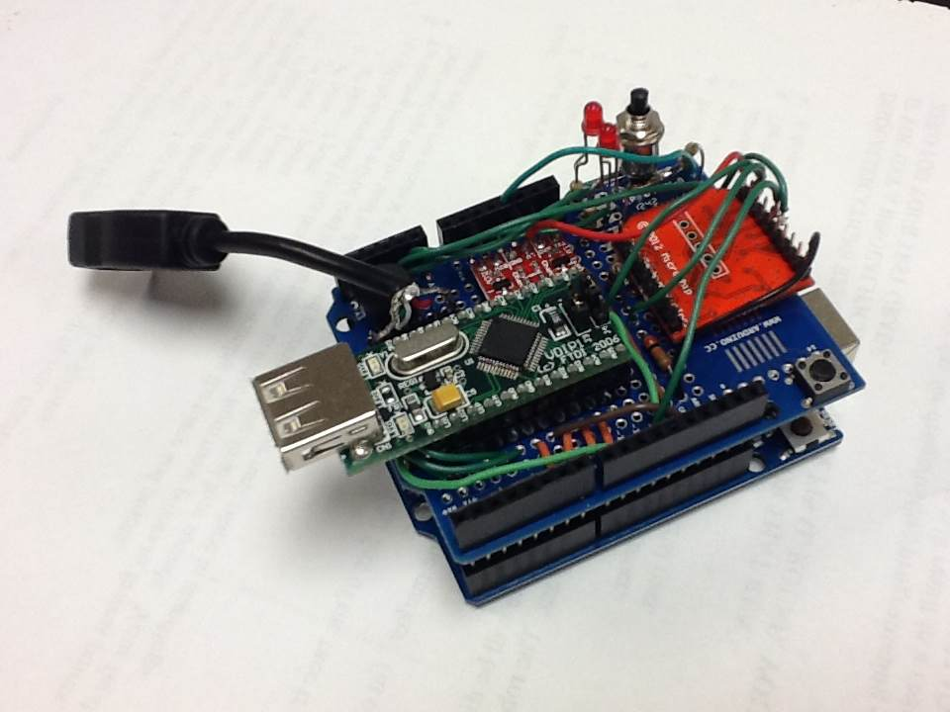
Board Schematic
Programming
Internal Design The ChapR contains an Arduino Uno module which we plug a shield into. The ChapR shield contains a few components:
VDIP (2 USB ports which receive joystick input)
LEDs (one red and one blue)
Speaker (to transmit information to the user)
Button (to make the ChapR bluetooth discoverable or release a waitForStart)
Bluetooth module (which sends the joystick input to the NXT)
Overall Layout After the joysticks are plugged in, the ChapR pulls the joystick readings from the USB ports and formats them into something the NXT can understand and use while running its program. Then those signals are sent out over Bluetooth to the NXT.
See http://chapr.weebly.com/ for more information!

